Slide 1

Ratings Prediction
Presented By
Shivanchal Asthana

Slide 2
Table of Content
Introduction
Benefits of Malignant Comments Classifier
Problem statement
Objectives
Research Methodology
Data Analysis/ Visualizations/ Observations
Conclusions

Slide 3
Introduction
This is a Machine Learning Project performed on customer reviews. Reviews are processed using common NLP techniques.
Millions of people use Amazon and Flipkart to buy products. For every product, people can rate and write a review. If a product is good, it gets a positive review and gets a higher star rating, similarly, if a product is bad, it gets a negative review and lower star rating. My aim in this project is to predict star rating automatically based on the product review.
The range of star rating is 1 to 5. That means if the product review is negative, then it will get low star rating (possibly 1 or 2), if the product is average then it will get medium star rating (possibly 3), and if the product is good, then it will get higher star rating (possibly 4 or 5).
This task is similar to Sentiment Analysis, but instead of predicting the positive and negative sentiment (sometimes neutral also), here we need to predict the rating.

Slide 4
About Problem Statement
The rise in e-commerce has brought a significant rise in the importance of customer reviews. There are hundreds of review sites online and massive amounts of reviews for every product. Customers have changed their way of shopping and according to a recent survey, 70 percent of customers say that they use rating filters to filter out low rated items in their searches.
The ability to successfully decide whether a review will be helpful to other customers and thus give the product more exposure is vital to companies that support these reviews, companies like Google, Amazon, Flipkart etc.
There are two main methods to approach this problem. The first one is based on review text content analysis and uses the principles of natural language process (the NLP method). This method lacks the insights that can be drawn from the relationship between costumers and items. The second one is based on recommender systems, specifically on collaborative filtering and focuses on the reviewer’s point of view.

Slide 5
Objectives
Create an analytical framework to understand
- Key factors impacting how much comment is malignant or not
Develop a modelling framework
- To check the Ratings of any product.

Slide 6
Research Methodology
The research methodology adopted for this is given as follows:
Research design: The research design adopted for this study is descriptive research design. The descriptive research design focuses on the accurate description of the variables present in the problem.
Sampling: Sampling allows concentrating upon a relatively smaller number of people and hence, to devote more energy that the information collected from them is accurate.
Sampling Size: The total size of the sample is 153164 respondents.

Slide 7
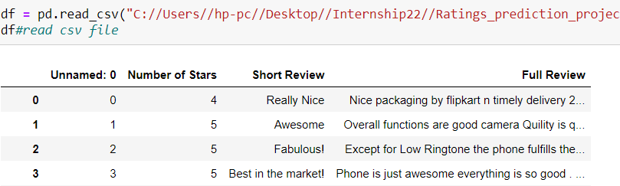
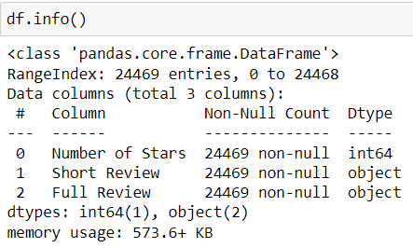

Data Analysis and Interpretation
We have scraped dataset now
Dataset contains 24469 rows and 3 columns
Number of stars column are in integer form rest all are object form.

Slide 8
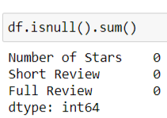
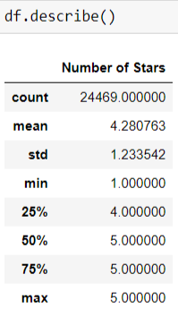

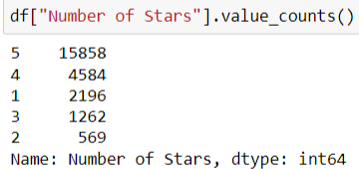
Data Understanding
There are no null values
Number of stars columns have 5 types of stars 1,2,3,4,5
5 stars are more than others

Slide 9
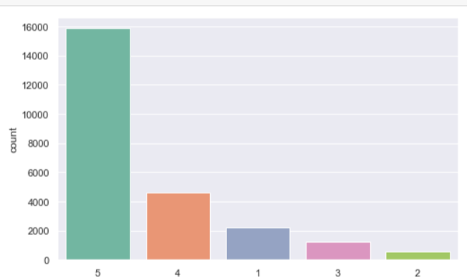
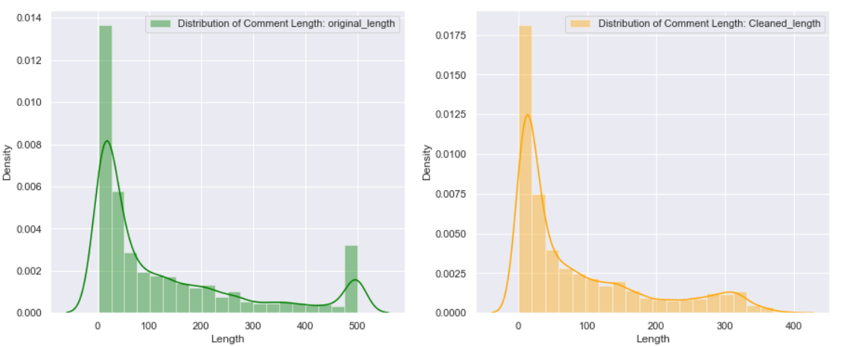
Data
Understanding
We can see, 5 star rating is high and 1 star is very low
We see the distribution of original length and cleaned length

Slide 10
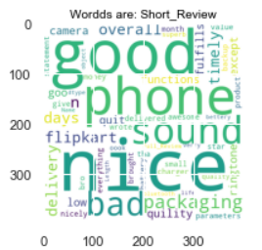
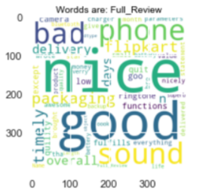
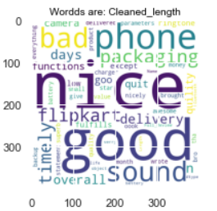
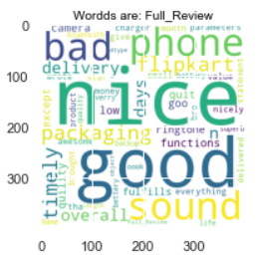
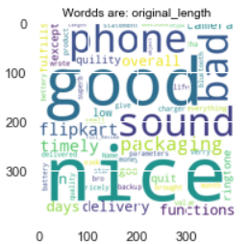
Data
Understanding
1. By using wordcloud, we see the words in short review and full review columns.

Slide 11
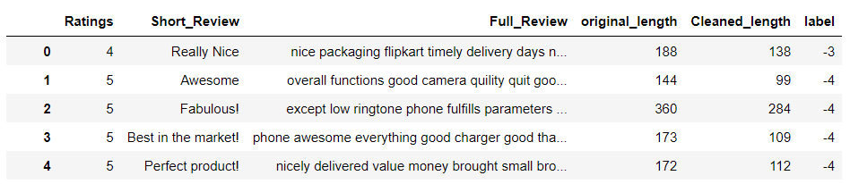
Data
Understanding
Cleaned dataset

Slide 12
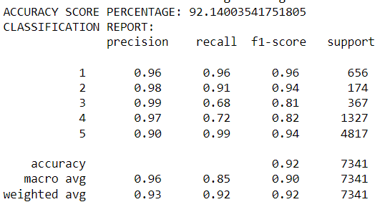
Logistic Regression
It is giving us 92% accuracy

Slide 13
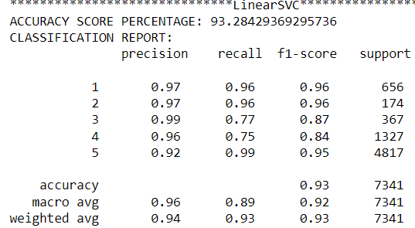
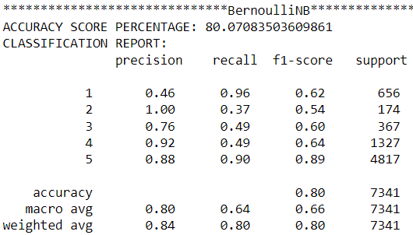
linear SVC
&
BernouliNB
LinearSVC is giving us 93% accuracy
BernouliNB is giving us 80% Accuracy.

Slide 14
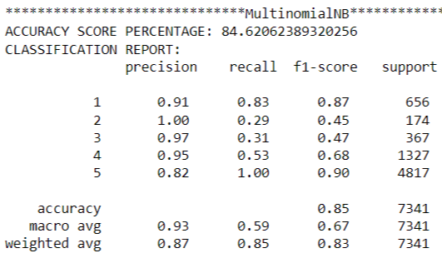
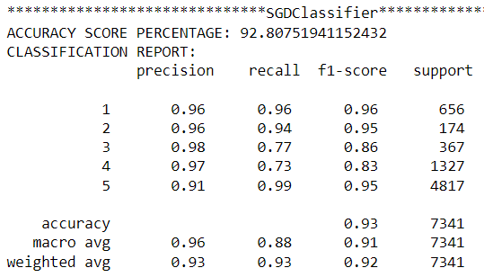
MultinomialNB
&
SGDClassifier
MultinomialNB is giving us 85% Accuracy
SGDClassifier is giving us 93 Accuracy

Slide 15
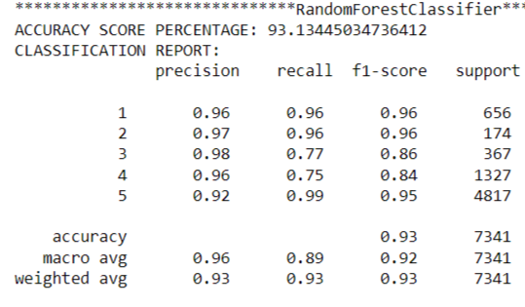
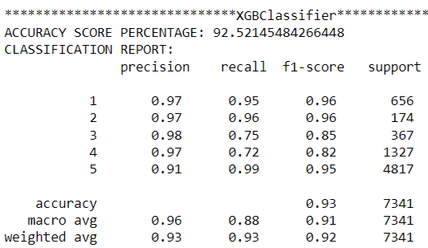
RandomForest
Classifier
&
XGBClassifier
RandomForestClassifer is giving us 93% Accuracy
XGBClassifier is giving us 93% Accuracy

Slide 16
Conclusion
1. RandomForestClassifier is giving us 93% Accuracy, So, this is our best model.

Slide 17
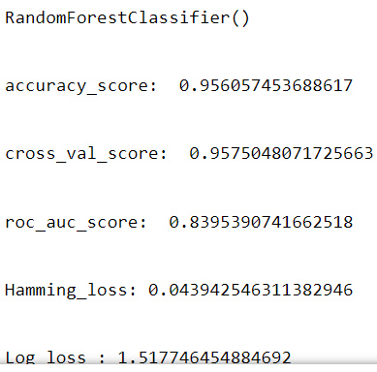
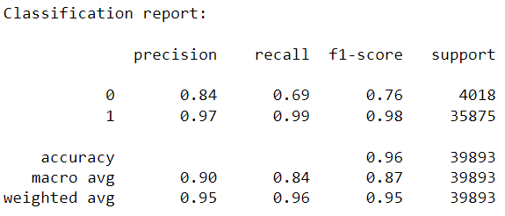
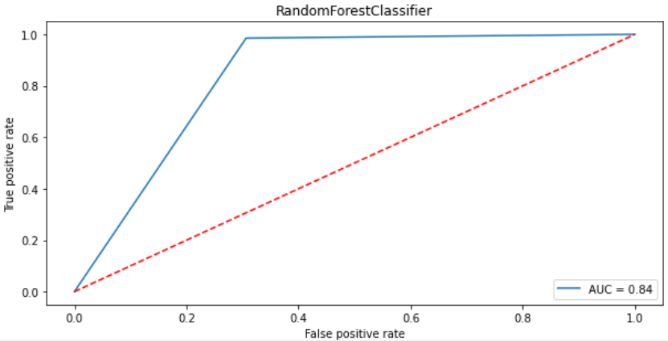
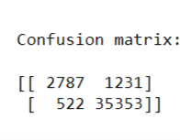
RandomForest
Classifier
1. RandomForestClassifier is giving us 96% Accuracy

Slide 18
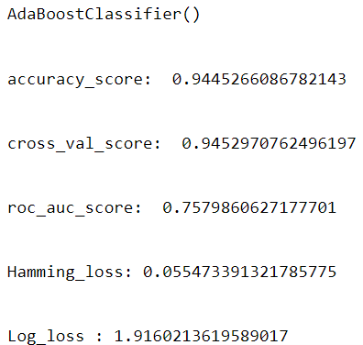
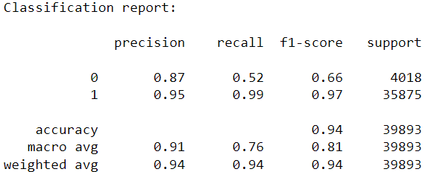
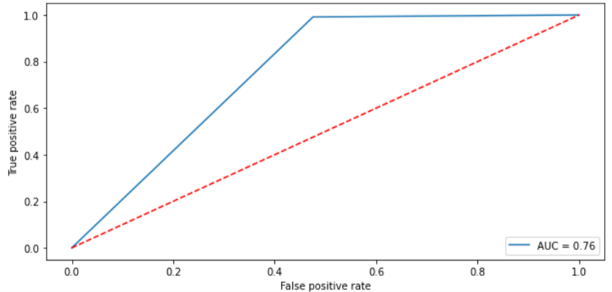
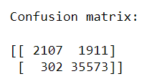
Ada Boost
Classifier
1. AdaBoostClassifier is giving us 94.6% Accuracy

Slide 19
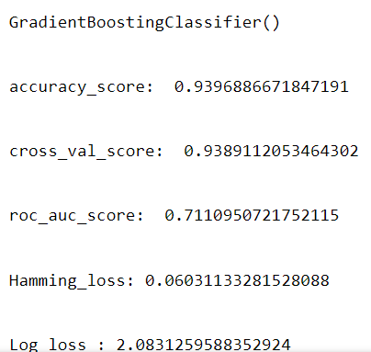
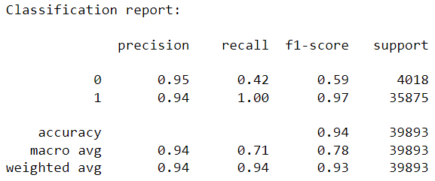
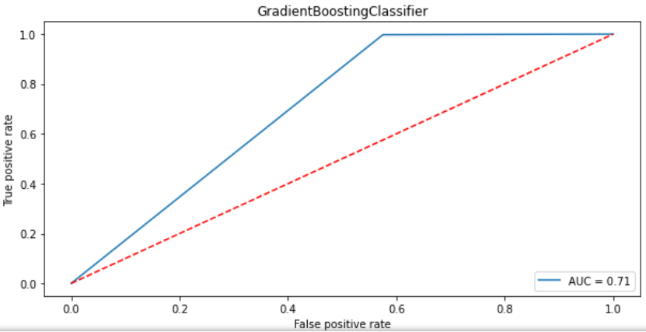
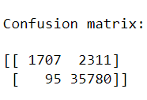
Gradient Boosting
Classifier
1. MultinomialNB is giving us 94.6% Accuracy

